Slide 1

Variational Shape Approximation
Presenter
Mumbai Indians
Ninad Kamat
Akash Sambrekar
Rahul Patil
Notes:
This is a fixed Carnegie Mellon image.
Place your cursor on the white text above and type in your text.
Main title: 40 pt. Times, Upper & lower case.
Presenter: 16 pt. Helvetica oblique
Name: 16 pt. Helvetica Bold
Presenters Title: 16 pt. Helvetica light

Slide 2
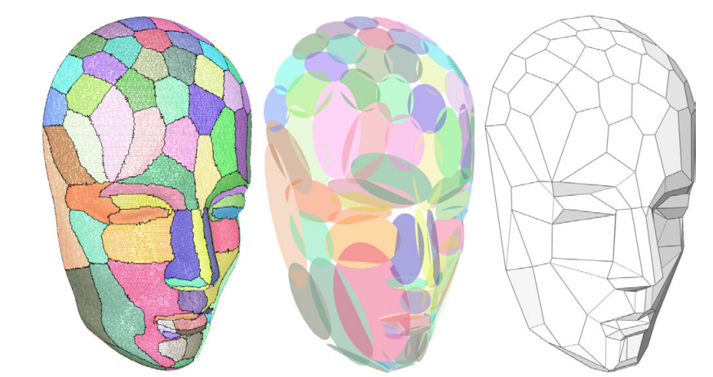
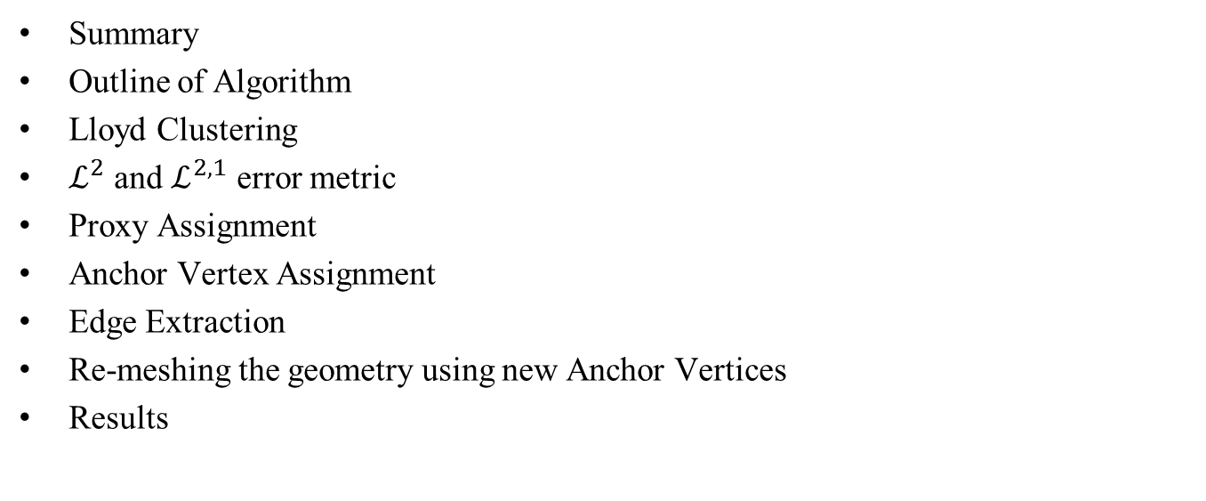
Outline
Summary
Outline of Algorithm
Lloyd Clustering
$ℒ^{2}$ and $ℒ^{2,1}$ error metric
Proxy Assignment
Anchor Vertex Assignment
Edge Extraction
Re-meshing the geometry using new Anchor Vertices
Results

Slide 3
Summary
Novel error driven technique
Reduces the size of a dense 3D dataset without losing key geometric features.
Simple, yet effective
This paper uses the concept of geometric proxy(plane) which is defined by a point and normal to best approximate surfaces
Lloyd Clustering using an error metric to cluster original polygons into the best fitting proxy
Once the clusters are formed, we make anchor vertices at each boundary and extract edges
We then perform 3D triangulation to generate new mesh
The results can be visualized through the STL files

Slide 4
Algorithm Outline
Reading STL file
Store connectivity
Perform Lloyd Clustering
Add New Anchor Vertices
Extract New Edges
Make Anchor Vertices
New Triangulation
Store new connectivity
Write STL file

Slide 5

Reading STL
Reading STL file
Store connectivity
Perform Lloyd Clustering
Add New Anchor Vertices
Extract New Edges
Make Anchor Vertices
New Triangulation
Store new connectivity
Write STL file
Two types
Binary
Read binary
Convert from char to float and int
Ascii
Parsing
Store vertices and triangles

Slide 6
Storing Connectivity
Reading STL file
Store connectivity
Perform Lloyd Clustering
Add New Anchor Vertices
Extract New Edges
Make Anchor Vertices
New Triangulation
Store new connectivity
Write STL file
Use YsShell from Prof. Yamakawa’s Framework
Basically, allocate unique handles to all vertices and polygons
Store hashtable to trace connectivity
Polygon Handle to Vertex Handle
PolygonHandle to Edge
Store normal and Vertex Handles in a Polygon
We sincerely thank Prof. Yamakawa for writing such extensive libraries and letting us use them

Slide 7
Loading YsShell
Reading STL file
Store connectivity
Perform Lloyd Clustering
Add New Anchor Vertices
Extract New Edges
Make Anchor Vertices
New Triangulation
Store new connectivity
Write STL file
Use Lattice data structure to increase speed
Register vertices in lattice
Only check in lattice node whether vertex appears before
If existing, get Vertex Handle for vertex
Store polygon with all Vertex Handles
Store polygon normal

Slide 8
Proxy
Reading STL file
Store connectivity
Perform Lloyd Clustering
Add New Anchor Vertices
Extract New Edges
Make Anchor Vertices
New Triangulation
Store new connectivity
Write STL file
Contains two vectors – Position and Normal
Symbolic for a cluster
Proxy position
Barycenter of the cluster
Proxy Normal
Mean of all Polygon Normals in the cluster

Slide 9
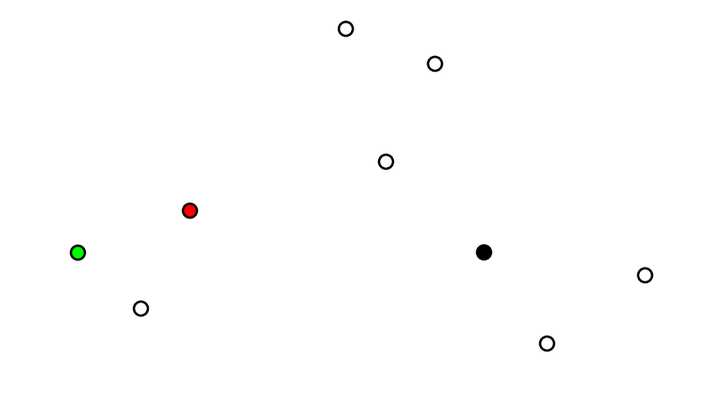
Clustering – k-means
Reading STL file
Store connectivity
Perform Lloyd Clustering
Add New Anchor Vertices
Extract New Edges
Make Anchor Vertices
New Triangulation
Store new connectivity
Write STL file
Assign “k” random centers initially – Lloyd method

Slide 10
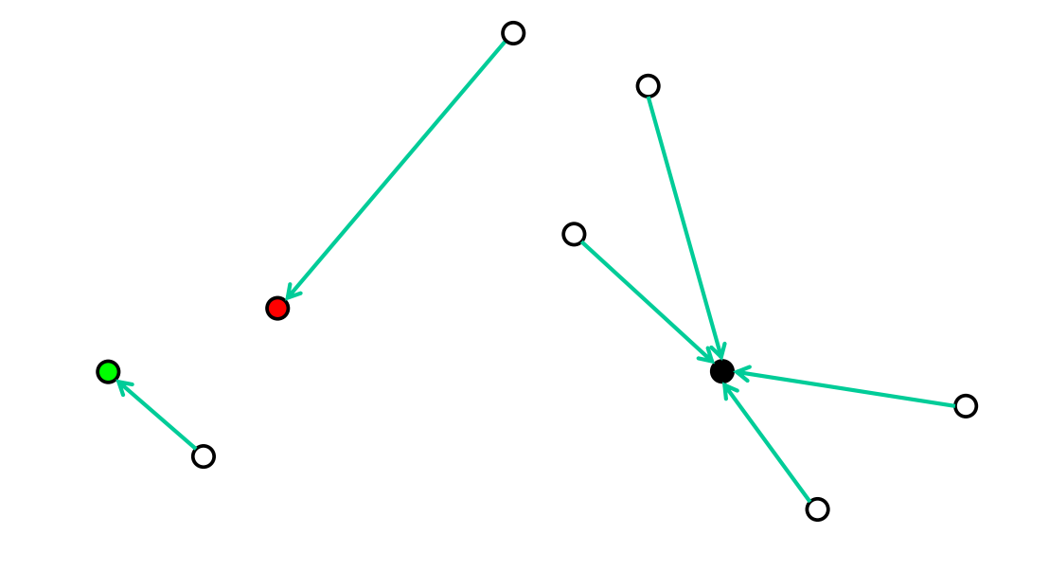
Clustering – k-means
Reading STL file
Store connectivity
Perform Lloyd Clustering
Add New Anchor Vertices
Extract New Edges
Make Anchor Vertices
New Triangulation
Store new connectivity
Write STL file
Assign “k” random centers initially – Lloyd method
Calculate cost function using centers and assign each vertex to center with lowest cost

Slide 11
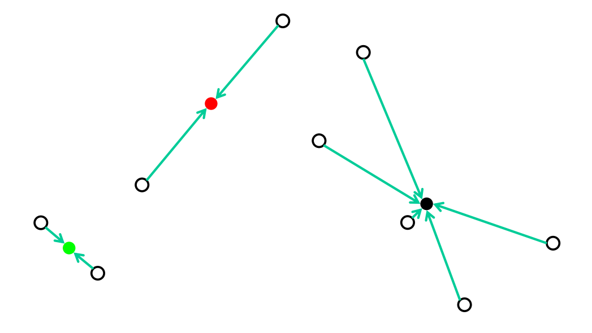
Clustering – k-means
Reading STL file
Store connectivity
Perform Lloyd Clustering
Add New Anchor Vertices
Extract New Edges
Make Anchor Vertices
New Triangulation
Store new connectivity
Write STL file
Assign “k” random centers initially – Lloyd method
Calculate cost function using centers and assign each vertex to center with lowest cost
Recalculate centers based on assignment

Slide 12
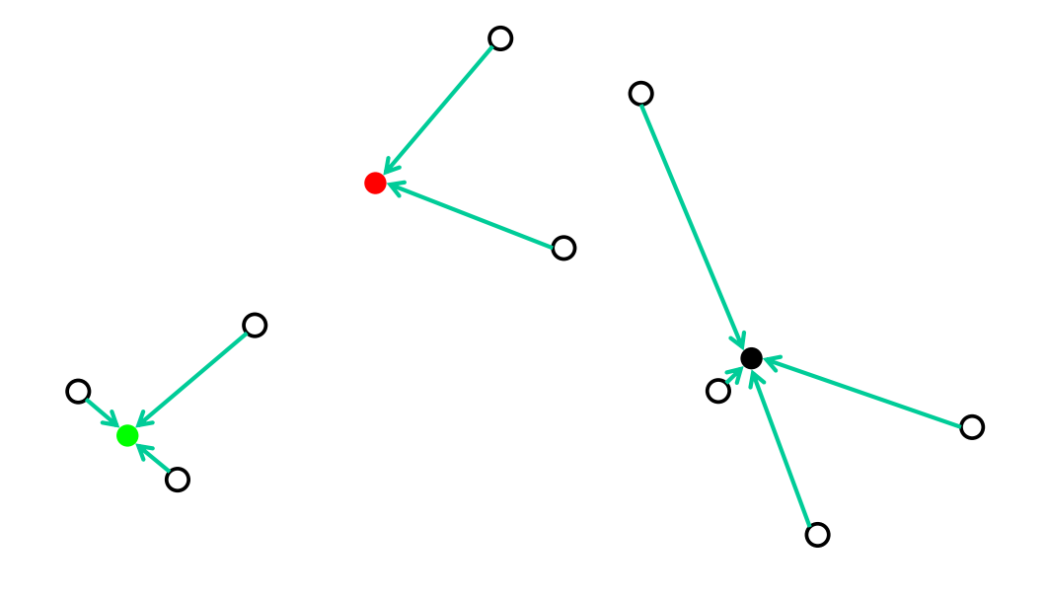
Clustering – k-means
Reading STL file
Store connectivity
Perform Lloyd Clustering
Add New Anchor Vertices
Extract New Edges
Make Anchor Vertices
New Triangulation
Store new connectivity
Write STL file
Assign “k” random centers initially – Lloyd method
Calculate cost function using centers and assign each vertex to center with lowest cost
Recalculate centers based on assignment
Iterate till change in tolerance within specified tolerance

Slide 13
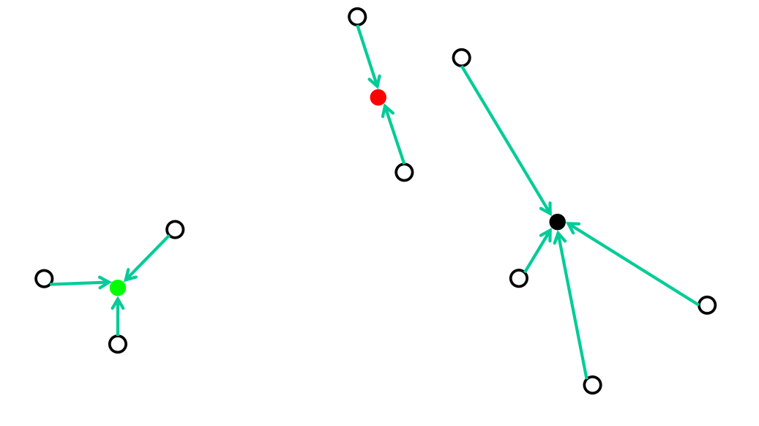
Clustering – k-means
Reading STL file
Store connectivity
Perform Lloyd Clustering
Add New Anchor Vertices
Extract New Edges
Make Anchor Vertices
New Triangulation
Store new connectivity
Write STL file
Assign “k” random centers initially – Lloyd method
Calculate cost function using centers and assign each vertex to center with lowest cost
Recalculate centers based on assignment
Iterate till change in tolerance within specified tolerance

Slide 14
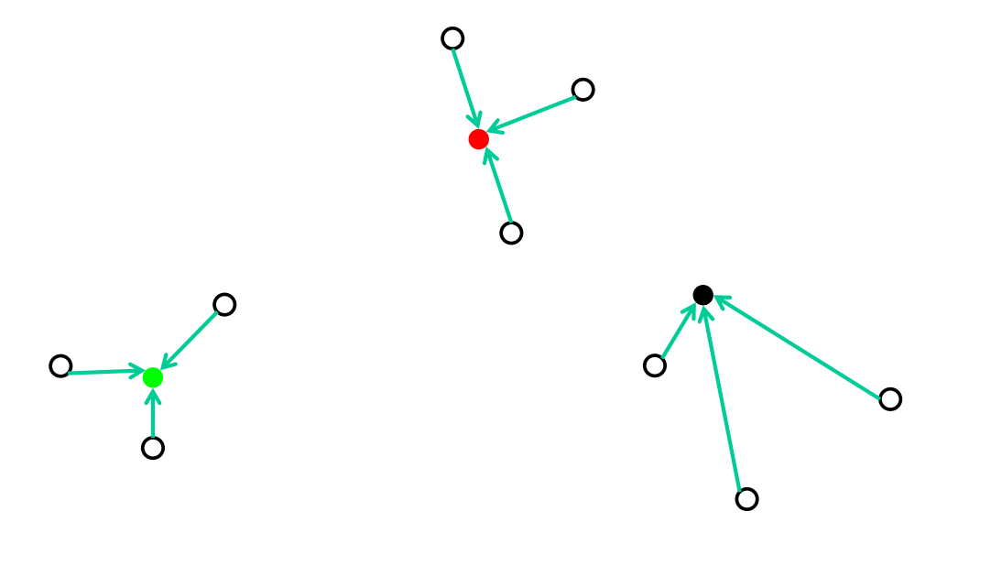
Clustering – k-means
Reading STL file
Store connectivity
Perform Lloyd Clustering
Add New Anchor Vertices
Extract New Edges
Make Anchor Vertices
New Triangulation
Store new connectivity
Write STL file
Assign “k” random centers initially – Lloyd method
Calculate cost function using centers and assign each vertex to center with lowest cost
Recalculate centers based on assignment
Iterate till change in tolerance within specified tolerance

Slide 15
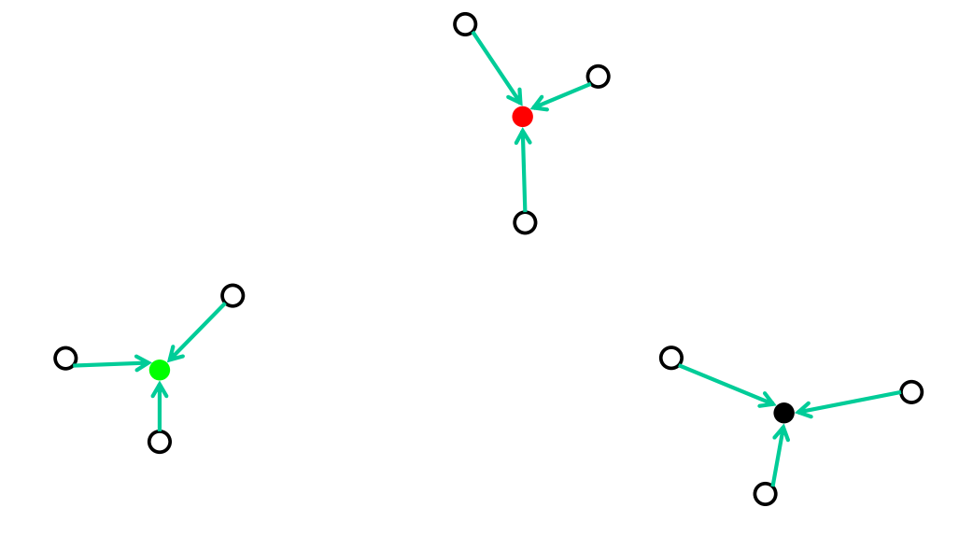
Clustering – k-means
Reading STL file
Store connectivity
Perform Lloyd Clustering
Add New Anchor Vertices
Extract New Edges
Make Anchor Vertices
New Triangulation
Store new connectivity
Write STL file
Assign “k” random centers initially – Lloyd method
Calculate cost function using centers and assign each vertex to center with lowest cost
Recalculate centers based on assignment
Iterate till change in tolerance within specified tolerance
Optimum!!

Slide 16
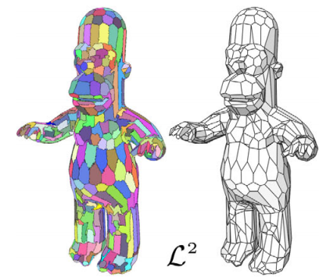
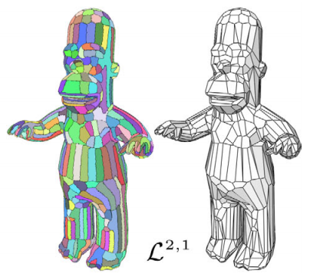
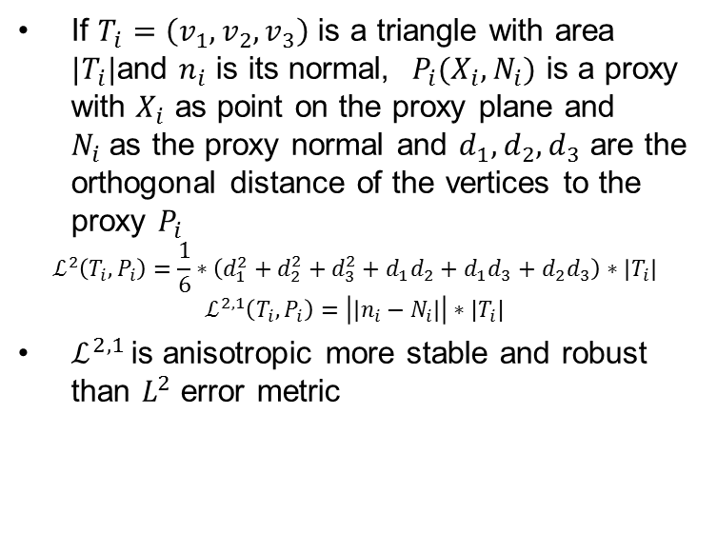
Error Metric
Reading STL file
Store connectivity
Perform Lloyd Clustering
Add New Anchor Vertices
Extract New Edges
Make Anchor Vertices
If $T_{i}=\left(v_{1},v_{2},v_{3}\right)$ is a triangle with area ${|T}_{i}|$and $n_{i}$ is its normal, $P_{i}(X_{i},N_{i})$ is a proxy with $X_{i}$ as point on the proxy plane and $N_{i}$as the proxy normal and $d_{1},d_{2},d_{3}$ are the orthogonal distance of the vertices to the proxy $P_{i}$
$$ℒ^{2}\left(T_{i},P_{i}\right)=\frac{1}{6}∗\left(d_{1}^{2}+d_{2}^{2}+d_{3}^{2}+d_{1}d_{2}+d_{1}d_{3}+d_{2}d_{3}\right)∗\left|T_{i}\right|$$
$$ℒ^{2,1}\left(T_{i},P_{i}\right)=\left|\left|n_{i}−N_{i}\right|\right|∗|T_{i}|$$
$ℒ^{2,1 }$is anisotropic more stable and robust than $L^{2}$ error metric
New Triangulation
Store new connectivity
Write STL file

Slide 17
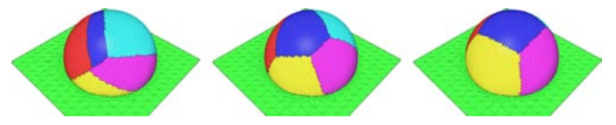
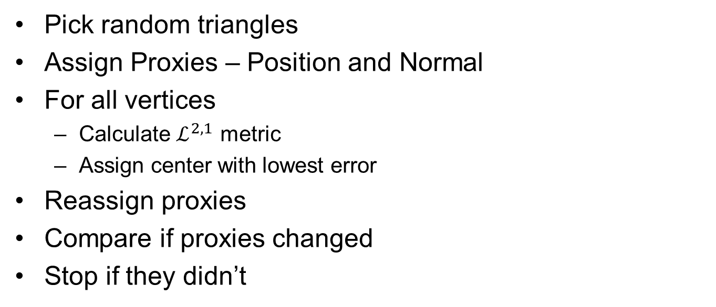
K-means in C++
Reading STL file
Store connectivity
Perform Lloyd Clustering
Add New Anchor Vertices
Extract New Edges
Make Anchor Vertices
New Triangulation
Store new connectivity
Write STL file
Pick random triangles
Assign Proxies – Position and Normal
For all vertices
Calculate $ℒ^{2,1}$ metric
Assign center with lowest error
Reassign proxies
Compare if proxies changed
Stop if they didn’t

Slide 18
Lloyd Cluster Class
Stores clusters in form of Hash Tables
Proxy Table
Connects Proxy to set of Polygons assigned to that Proxy
Polygon Table
Connects Polygon to a Label or Cluster

Slide 19
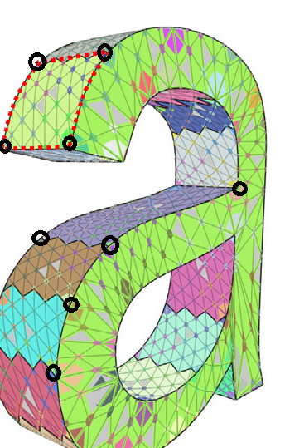
Anchor Vertex Assignment
Reading STL file
Store connectivity
Perform Lloyd Clustering
Add New Anchor Vertices
Extract New Edges
Make Anchor Vertices
New Triangulation
Store new connectivity
Write STL file
What is an Anchor Vertex?
Find vertices where 3 or more proxy planes meet
Find average of projections of this vertex on its neighboring proxies
Issue a pointer to the original vertex to maintain connectivity
Sanity Check!
Each proxy should have three or more Anchor vertices linked to it

Slide 20
The Anchor Class
Reading STL file
Store connectivity
Perform Lloyd Clustering
Add New Anchor Vertices
Extract New Edges
Make Anchor Vertices
Each instance of Anchor Class contains-
Vertex position
A vector which saves the labels of proxies with which the anchor is shared
A pointer to the original vertex from which the Anchor vertex originated
New Triangulation
Store new connectivity
Write STL file

Slide 21
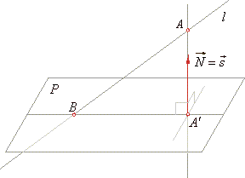
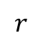
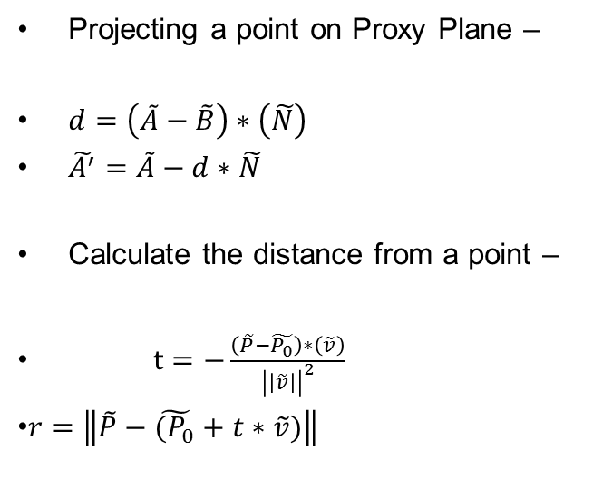
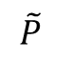
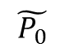
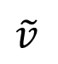
Geometric Computation
Reading STL file
Store connectivity
Perform Lloyd Clustering
Add New Anchor Vertices
Extract New Edges
Make Anchor Vertices
New Triangulation
Store new connectivity
Write STL file
Projecting a point on Proxy Plane –
$d=\left(\tilde{A}−\tilde{B}\right)∗\left(\tilde{N}\right)$
$\tilde{A^{′}}=\tilde{A}−d∗\tilde{N}$
Calculate the distance from a point –
$t=−\frac{\left(\tilde{P}−\tilde{P_{0}}\right)∗\left(\tilde{v}\right)}{{\left|\left|\tilde{v}\right|\right|}^{2}}$
$r=\left\|\tilde{P}−\tilde{(P_{0}}+t∗\tilde{v})\right\|$
$$\tilde{P}$$
$$\tilde{v}$$
$$r$$
$$\tilde{P_{0}}$$

Slide 22
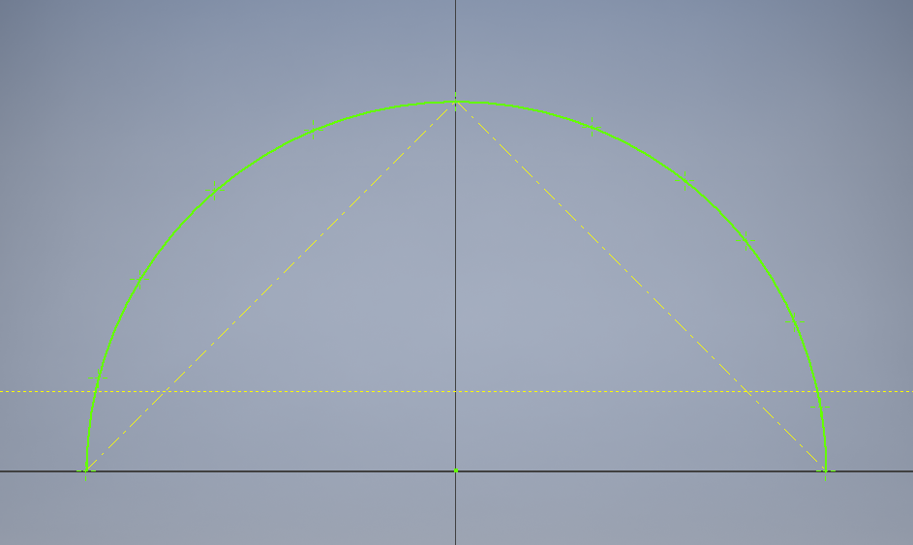
Adding more Anchor Vertices
Reading STL file
Store connectivity
Perform Lloyd Clustering
Add New Anchor Vertices
Extract New Edges
Make Anchor Vertices
New Triangulation
Store new connectivity
Write STL file
Reason
To accurately approximate the boundary arc of each proxy
To ensure accurate triangulation of approximant mesh faces
Approach
For each proxy, find all the vertices on the boundary arc
Initiate simple chord subdivision algorithm to approximate the boundary arc
Add new anchor vertices during subdivision

Slide 23
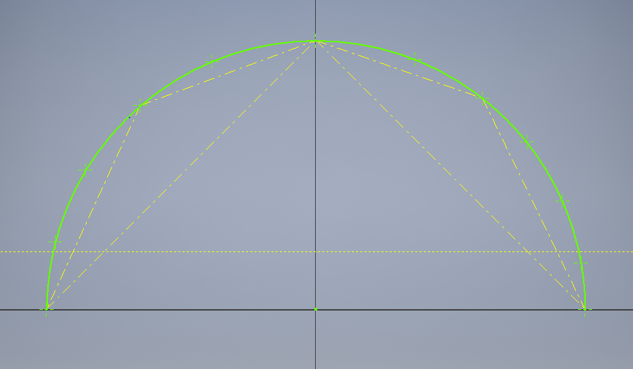
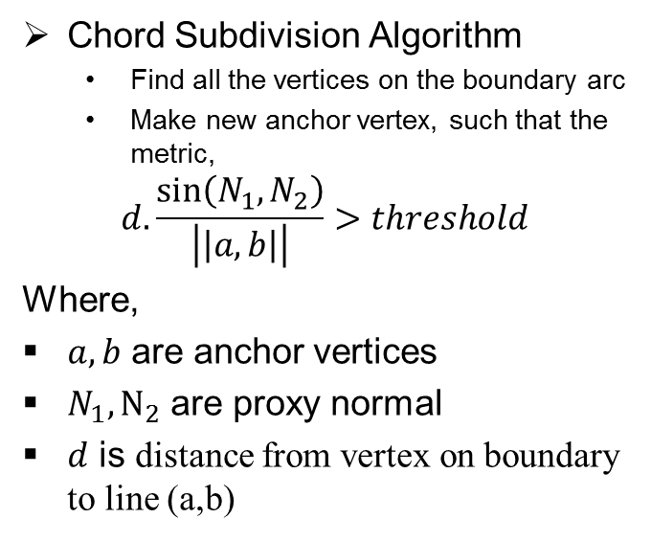
Edge Extraction
Reading STL file
Store connectivity
Perform Lloyd Clustering
Add New Anchor Vertices
Extract New Edges
Make Anchor Vertices
New Triangulation
Store new connectivity
Write STL file
Chord Subdivision Algorithm
Find all the vertices on the boundary arc
Make new anchor vertex, such that the metric,
$$d.\frac{\sin\left(N_{1},N_{2}\right)}{\left|\left|a,b\right|\right|}>threshold$$
Where,
$a,b$ are anchor vertices
$N_{1},N_{2}$ are proxy normal
$d$ is distance from vertex on boundary to line (a,b)

Slide 24
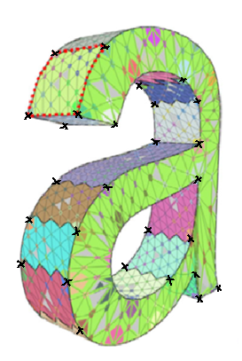
Triangulation
Reading STL file
Store connectivity
Perform Lloyd Clustering
Add New Anchor Vertices
Extract New Edges
Make Anchor Vertices
New Triangulation
Store new connectivity
Write STL file
Why Triangulation?
Anchors vertices of a proxy are not necessarily coplanar
Triangle ensures planar surface
Writing STL
Steps:
Assigning unique label to every anchor vertex
Traverse through all vertices in input STL and calculate distance from all anchor vertices
Assign label of closest anchor vertex
Traverse through all triangles of STL and find triangles having all vertices with different labels
These 3 different labels determine new connectivity

Slide 25
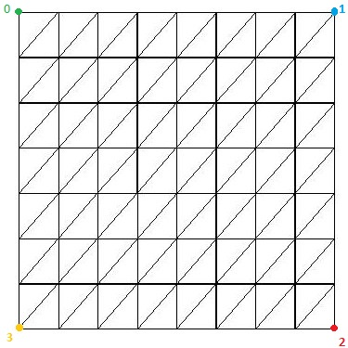
Step 1 – Assigning unique label
Reading STL file
Store connectivity
Perform Lloyd Clustering
Add New Anchor Vertices
Extract New Edges
Make Anchor Vertices
New Triangulation
Store new connectivity
Write STL file
We have array of all Anchor vertices
Assign index of each anchor vertex in the array as its label
Element Index | 0 | 1 | 2 | 3 | 4 | 5 | …
Element | a1 | a2 | a3 | a4 | a5 | a6 | …
Element label | 0 | 1 | 2 | 3 | 4 | 5 | …

Slide 26
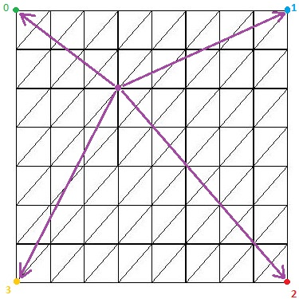
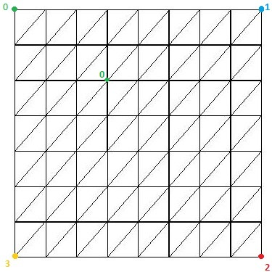
Step 2 – Distance of a vertex from all anchor vertices
Reading STL file
Store connectivity
Perform Lloyd Clustering
Add New Anchor Vertices
Extract New Edges
Make Anchor Vertices
New Triangulation
Store new connectivity
Write STL file
Minimum distance

Slide 27
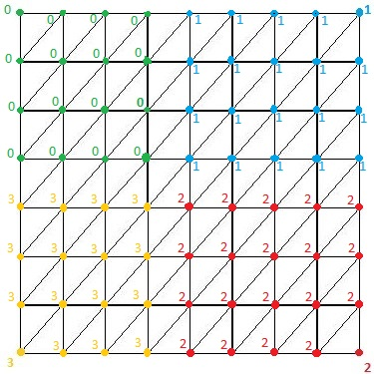
Step 3 – Assigning label to vertex
Reading STL file
Store connectivity
Perform Lloyd Clustering
Add New Anchor Vertices
Extract New Edges
Make Anchor Vertices
New Triangulation
Store new connectivity
Write STL file

Slide 28
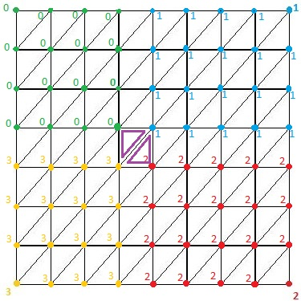
Step 4 – Triangles with vertices having different labels
Reading STL file
Store connectivity
Perform Lloyd Clustering
Add New Anchor Vertices
Extract New Edges
Make Anchor Vertices
New Triangulation
Store new connectivity
Write STL file
0 → 3 → 1
1 → 3 → 2

Slide 29
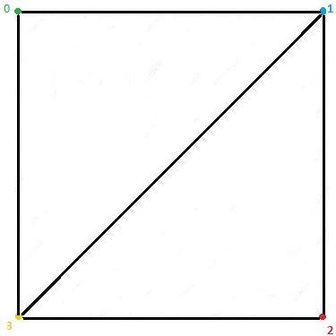
Step 5 – New connectivity
Reading STL file
Store connectivity
Perform Lloyd Clustering
Add New Anchor Vertices
Extract New Edges
Make Anchor Vertices
New Triangulation
Store new connectivity
Write STL file
0 → 3 → 1 and 1 → 3 → 2

Slide 30
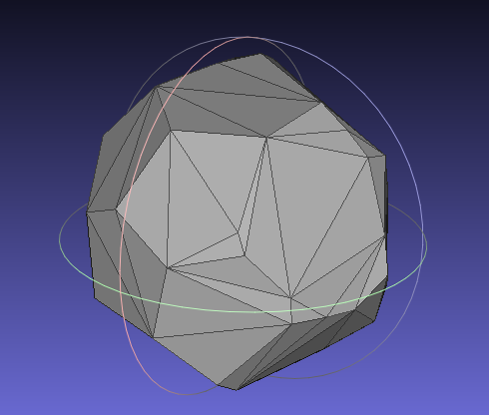
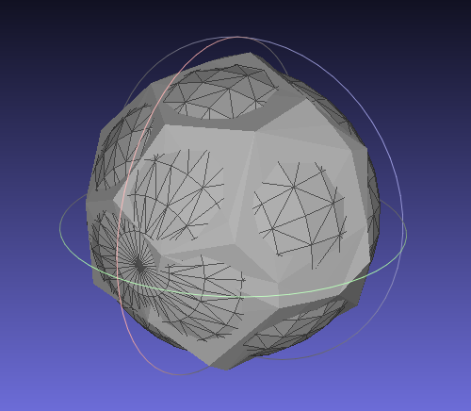
Results - Sphere
20 clusters

Slide 31
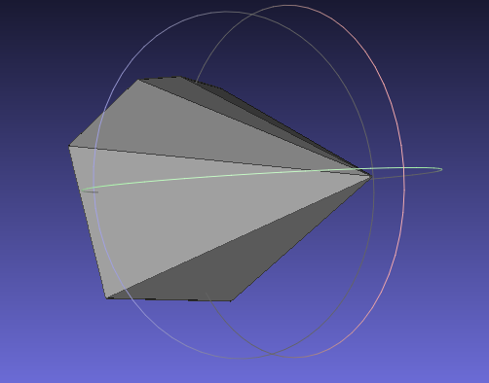
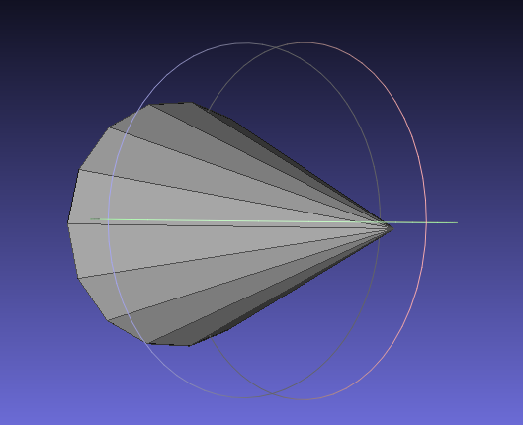
Results - Cone
10 clusters

Slide 32
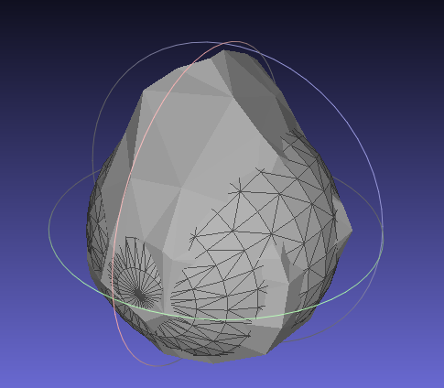
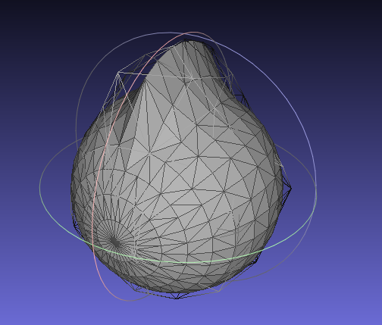
Results - Mohawk
30 clusters

Slide 33
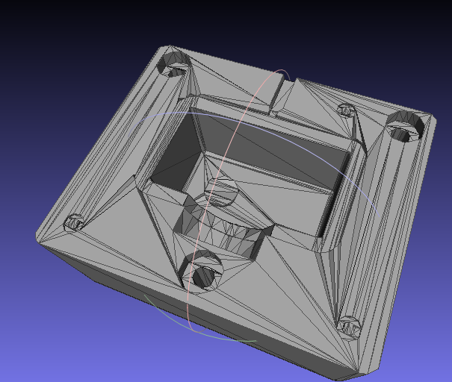
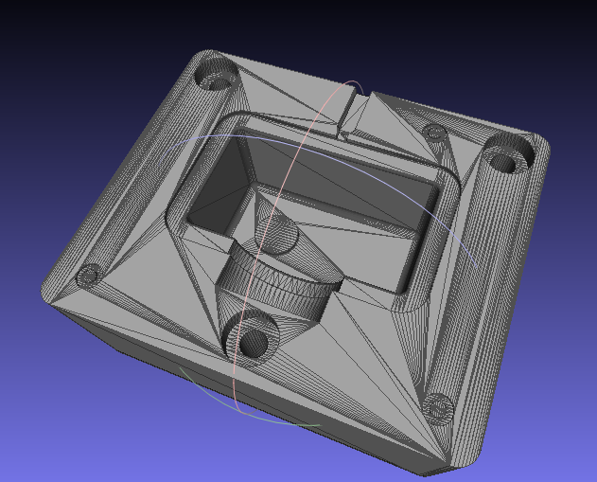
Results – ktoolcav.stl
25 clusters

Slide 34
Conclusion
A simple, yet effective way of compressing the data without losing key geometric features
Departs from the conventional method of linear piecewise approximation of the original surface
Computationally efficient
Provides concise geometric representations either in the form of local best-fit geometric plane or in the form of a polygonal mesh

Slide 35
Future Work
Automatic recognition of number of proxies
Implement Constrained Delaunay Triangulation
Reduce the number of redundant polygons in a given proxy such that the proxy normal does not change by more than a given threshold
There are some more bugs, but we won’t tell them to you!!

Slide 36

Any Questions ???
Reference
David Cohen-Steiner, Pierre Alliez, and Mathieu Desbrun, Variational Shape Approximation, Proceedings of SIGGRAPH 2004, pp. 905-914, 2004

Slide 37


